Slide 1

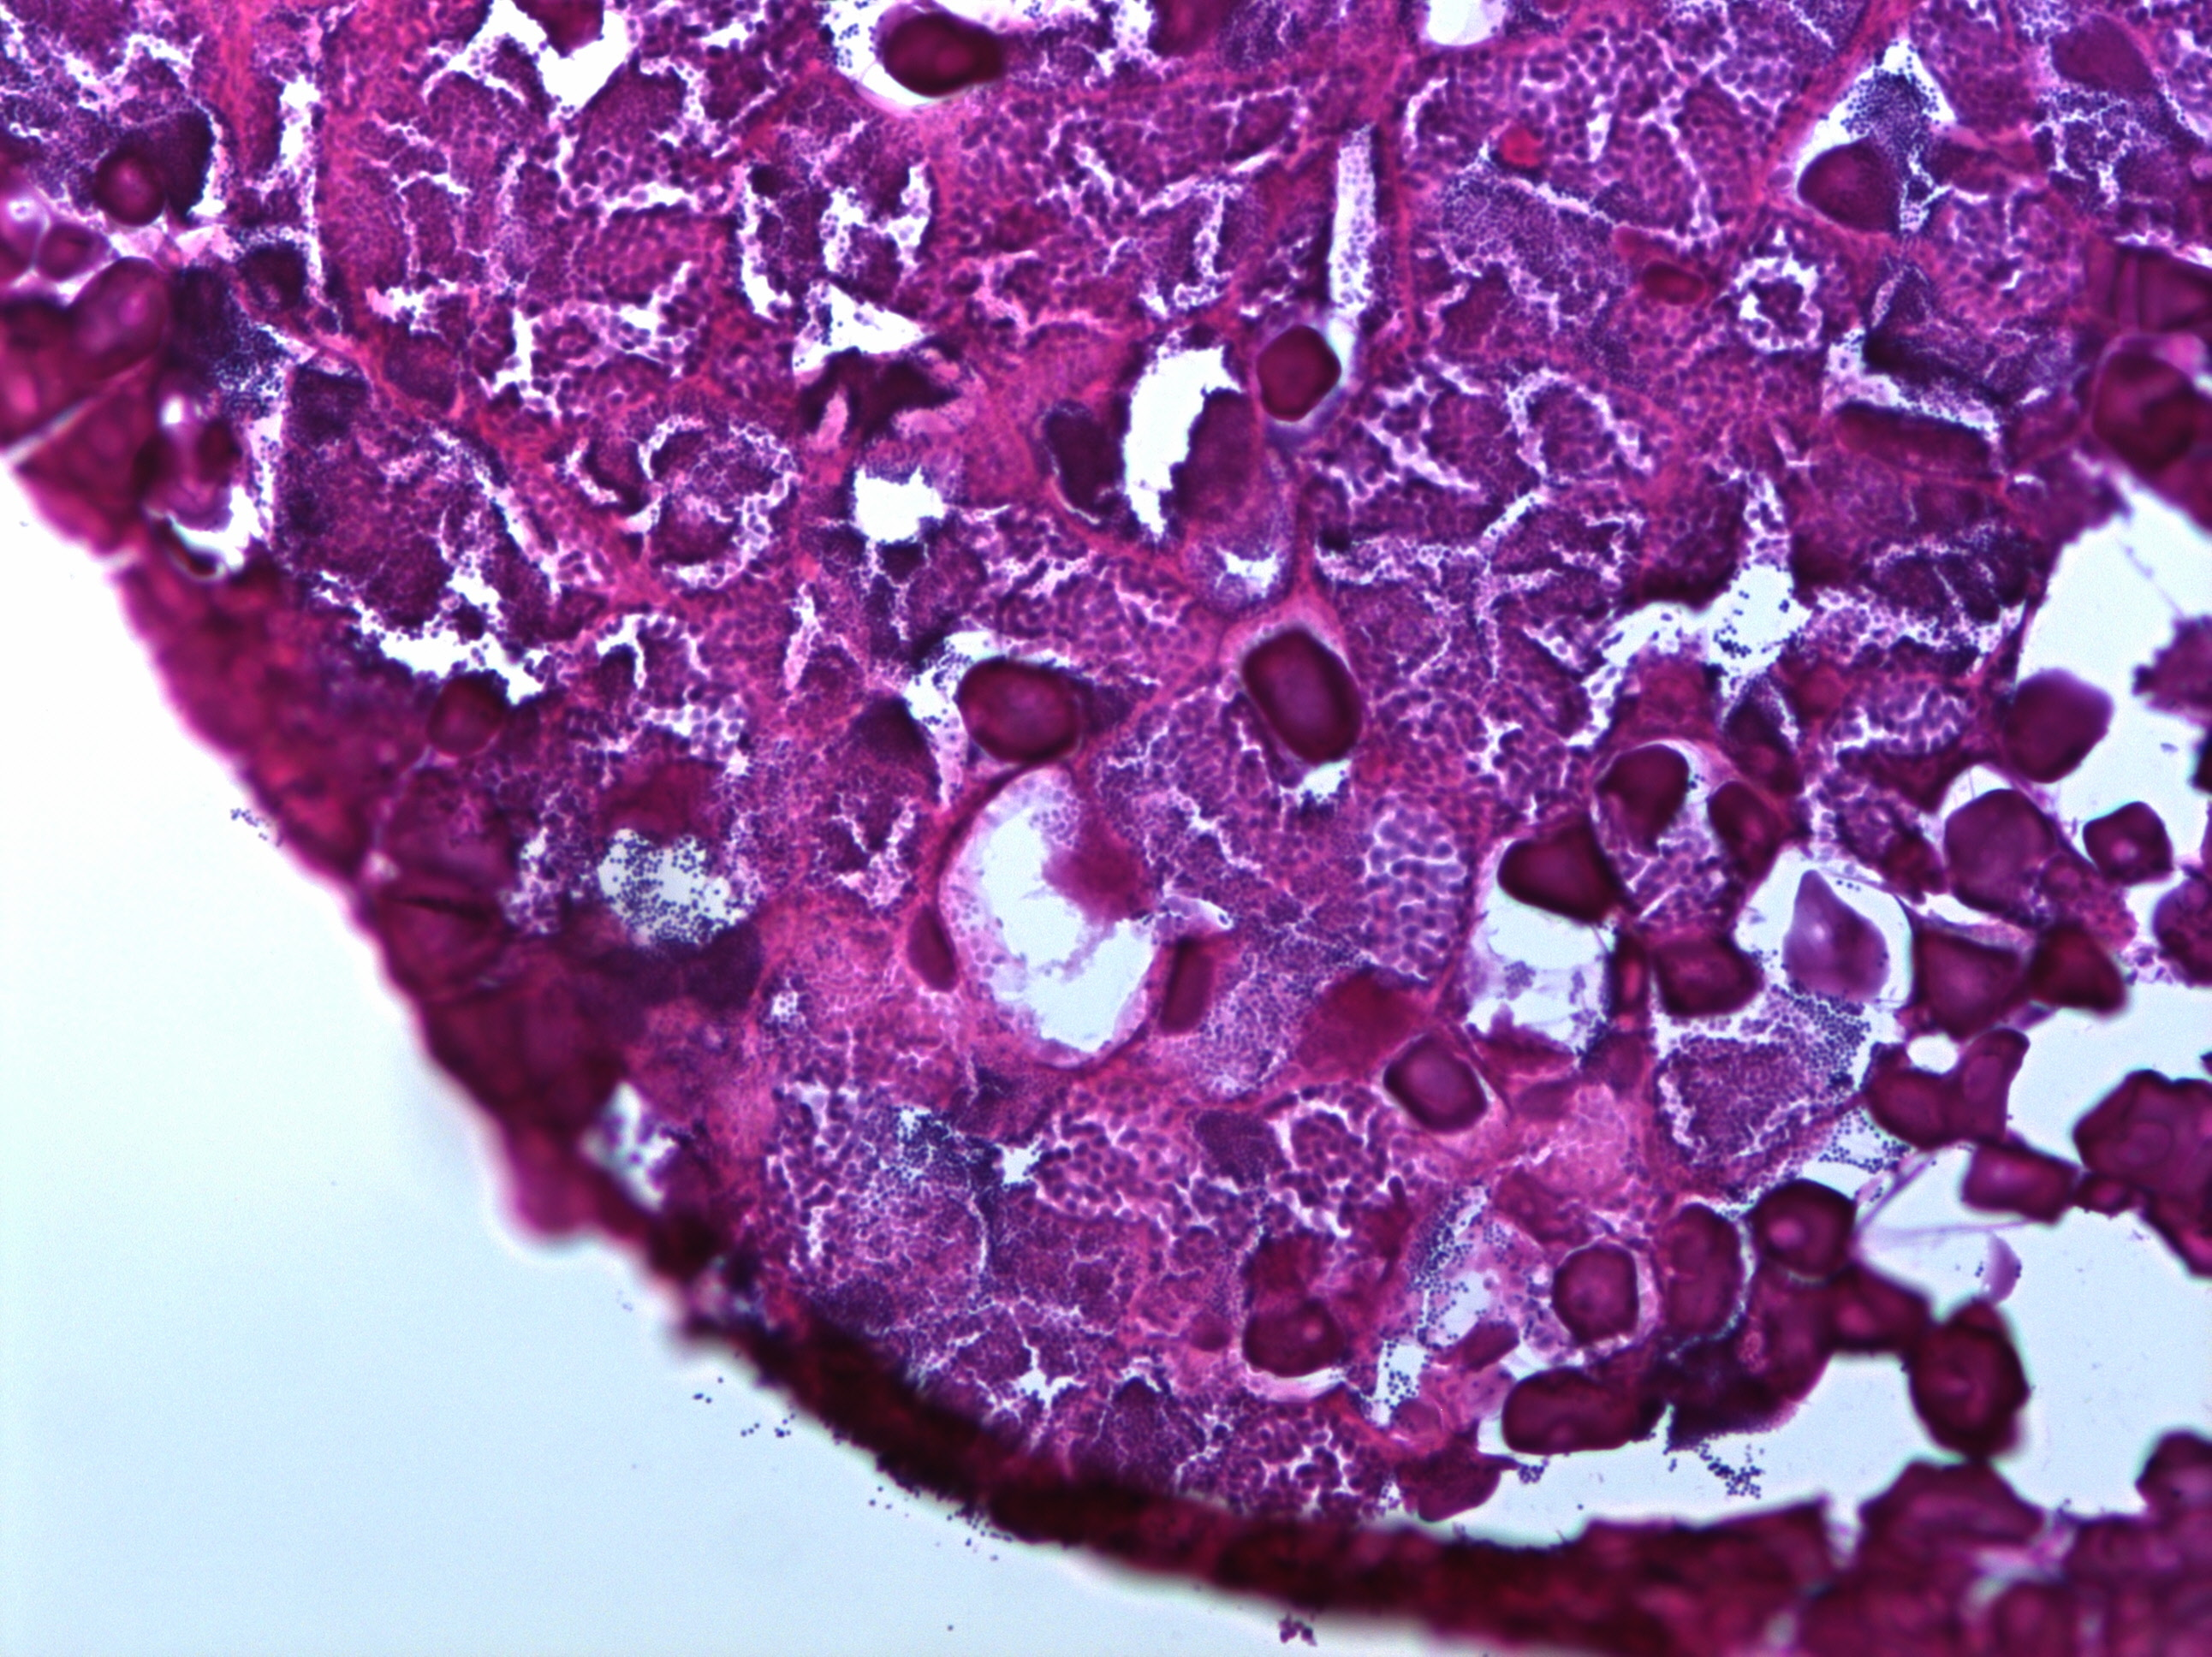
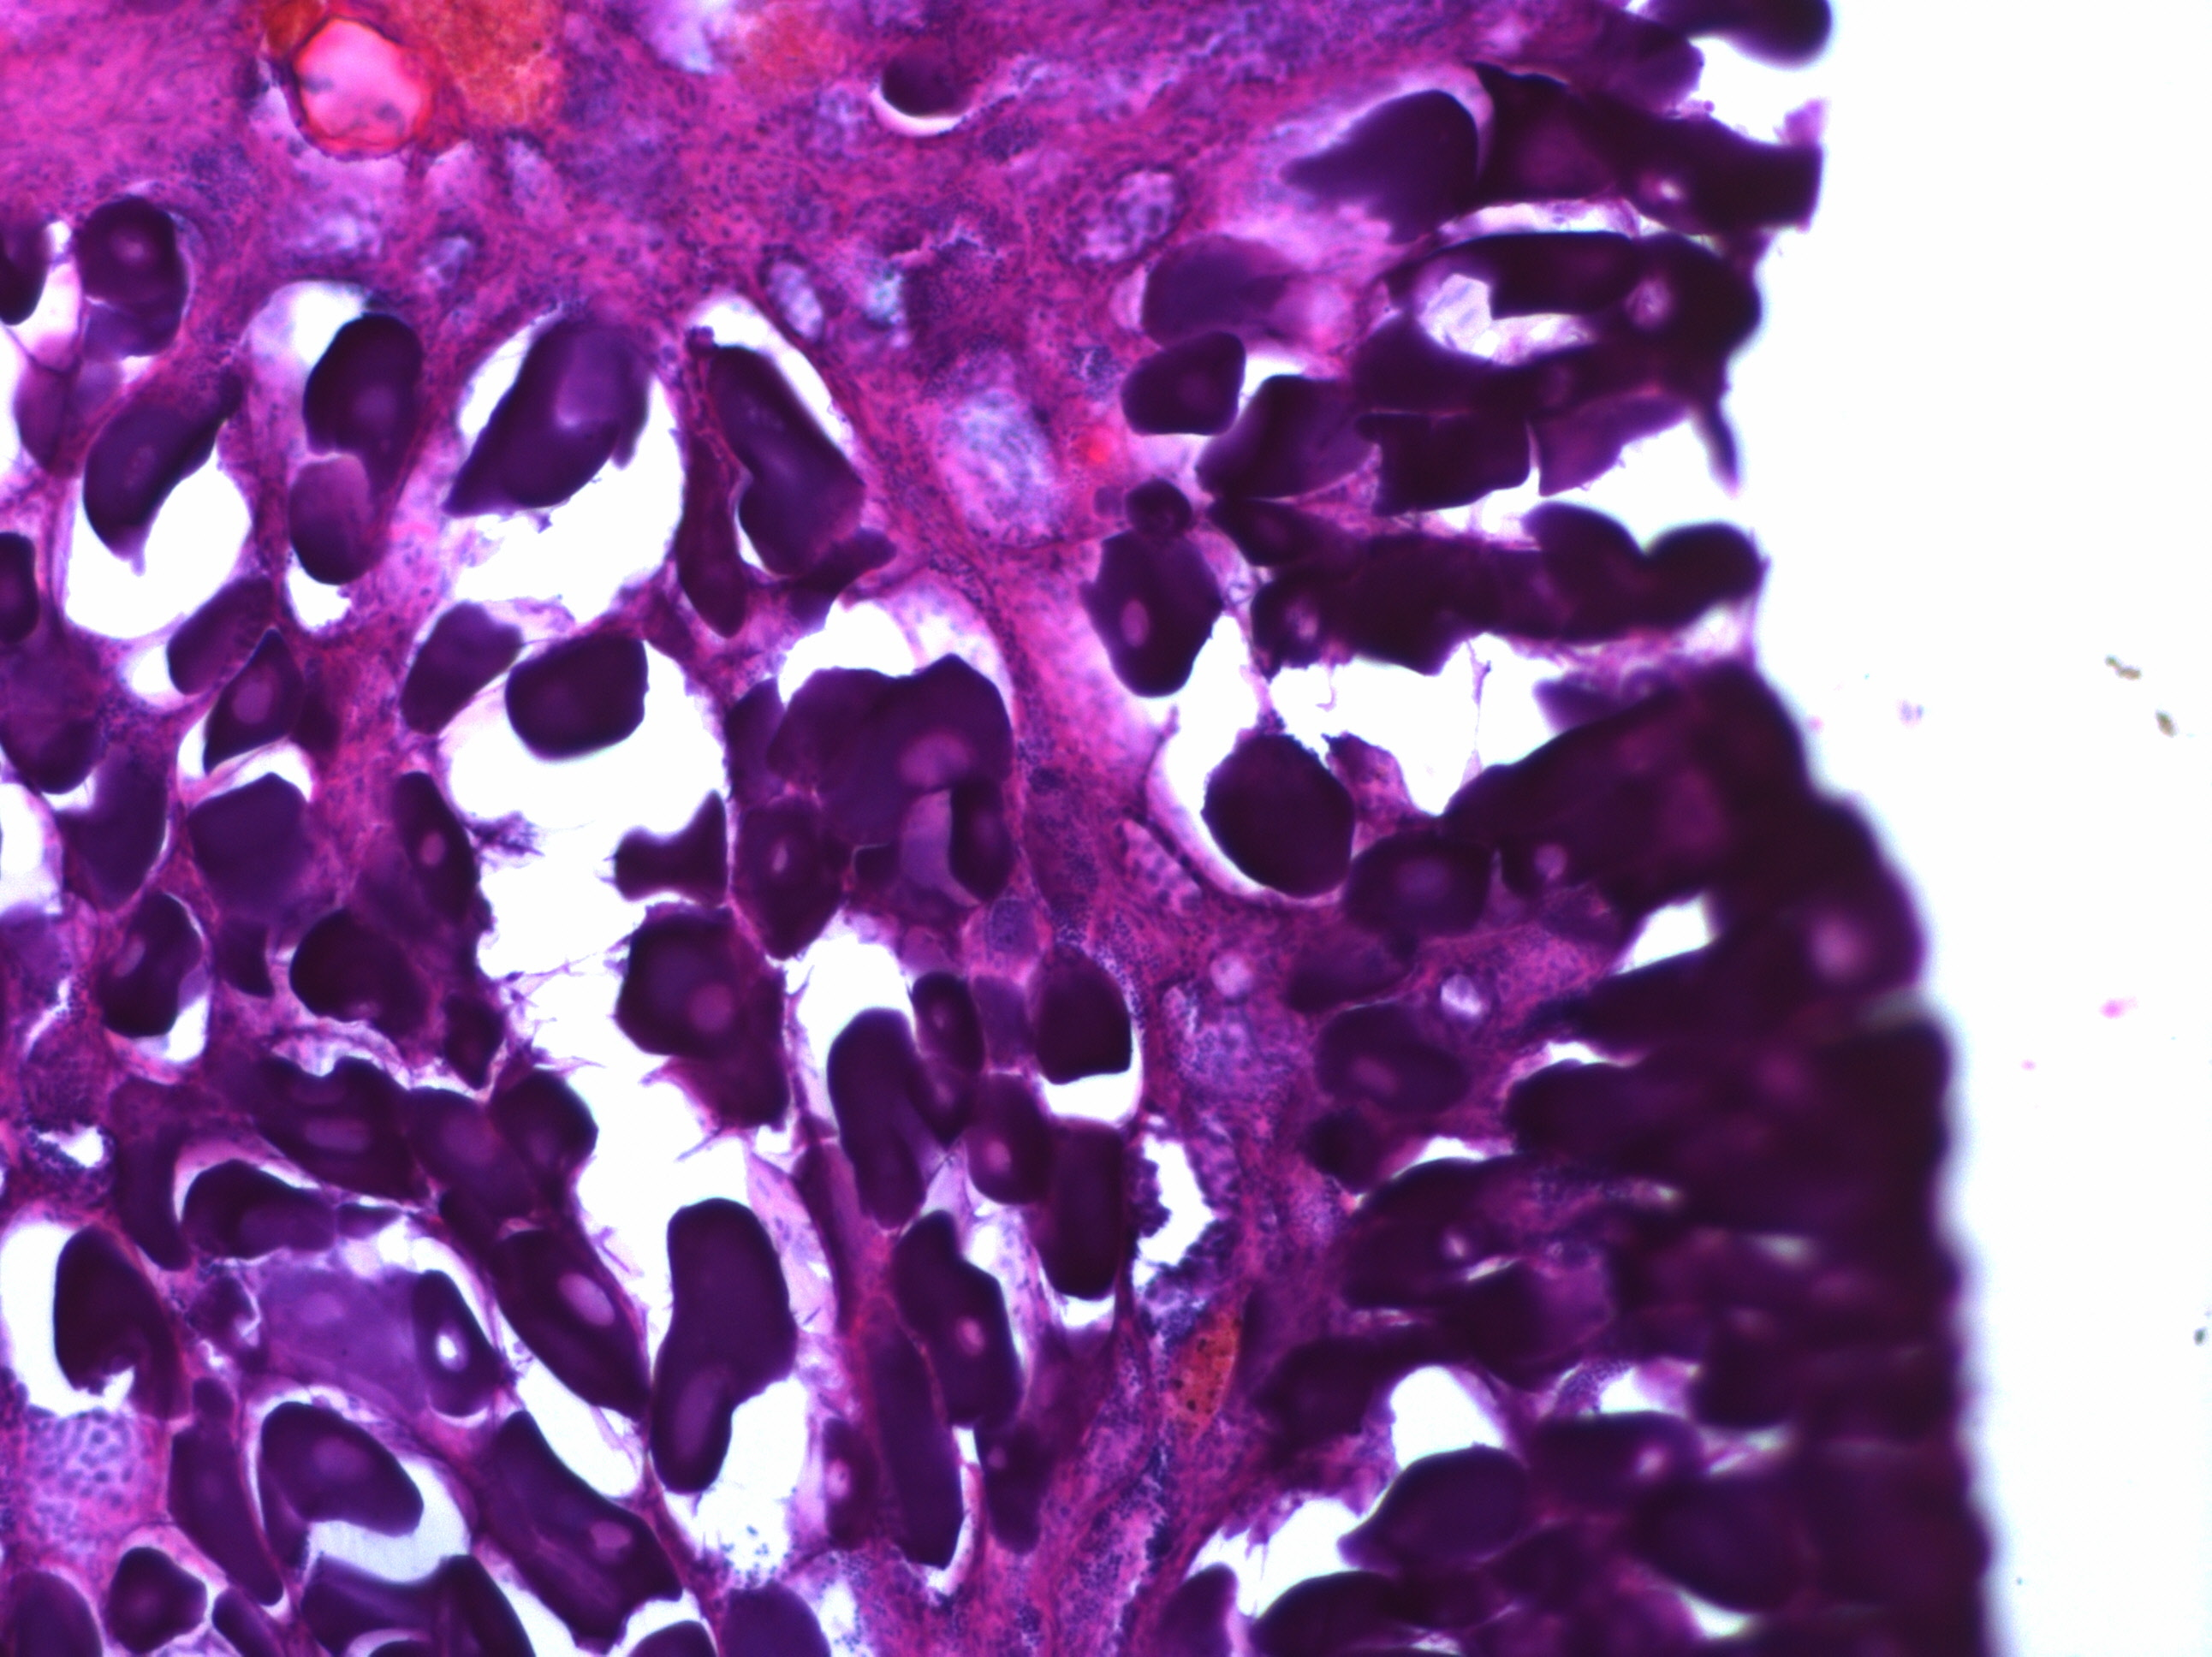
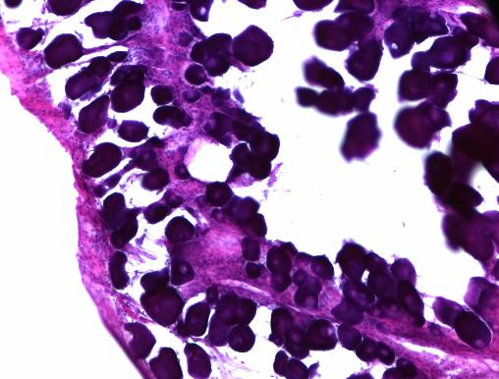
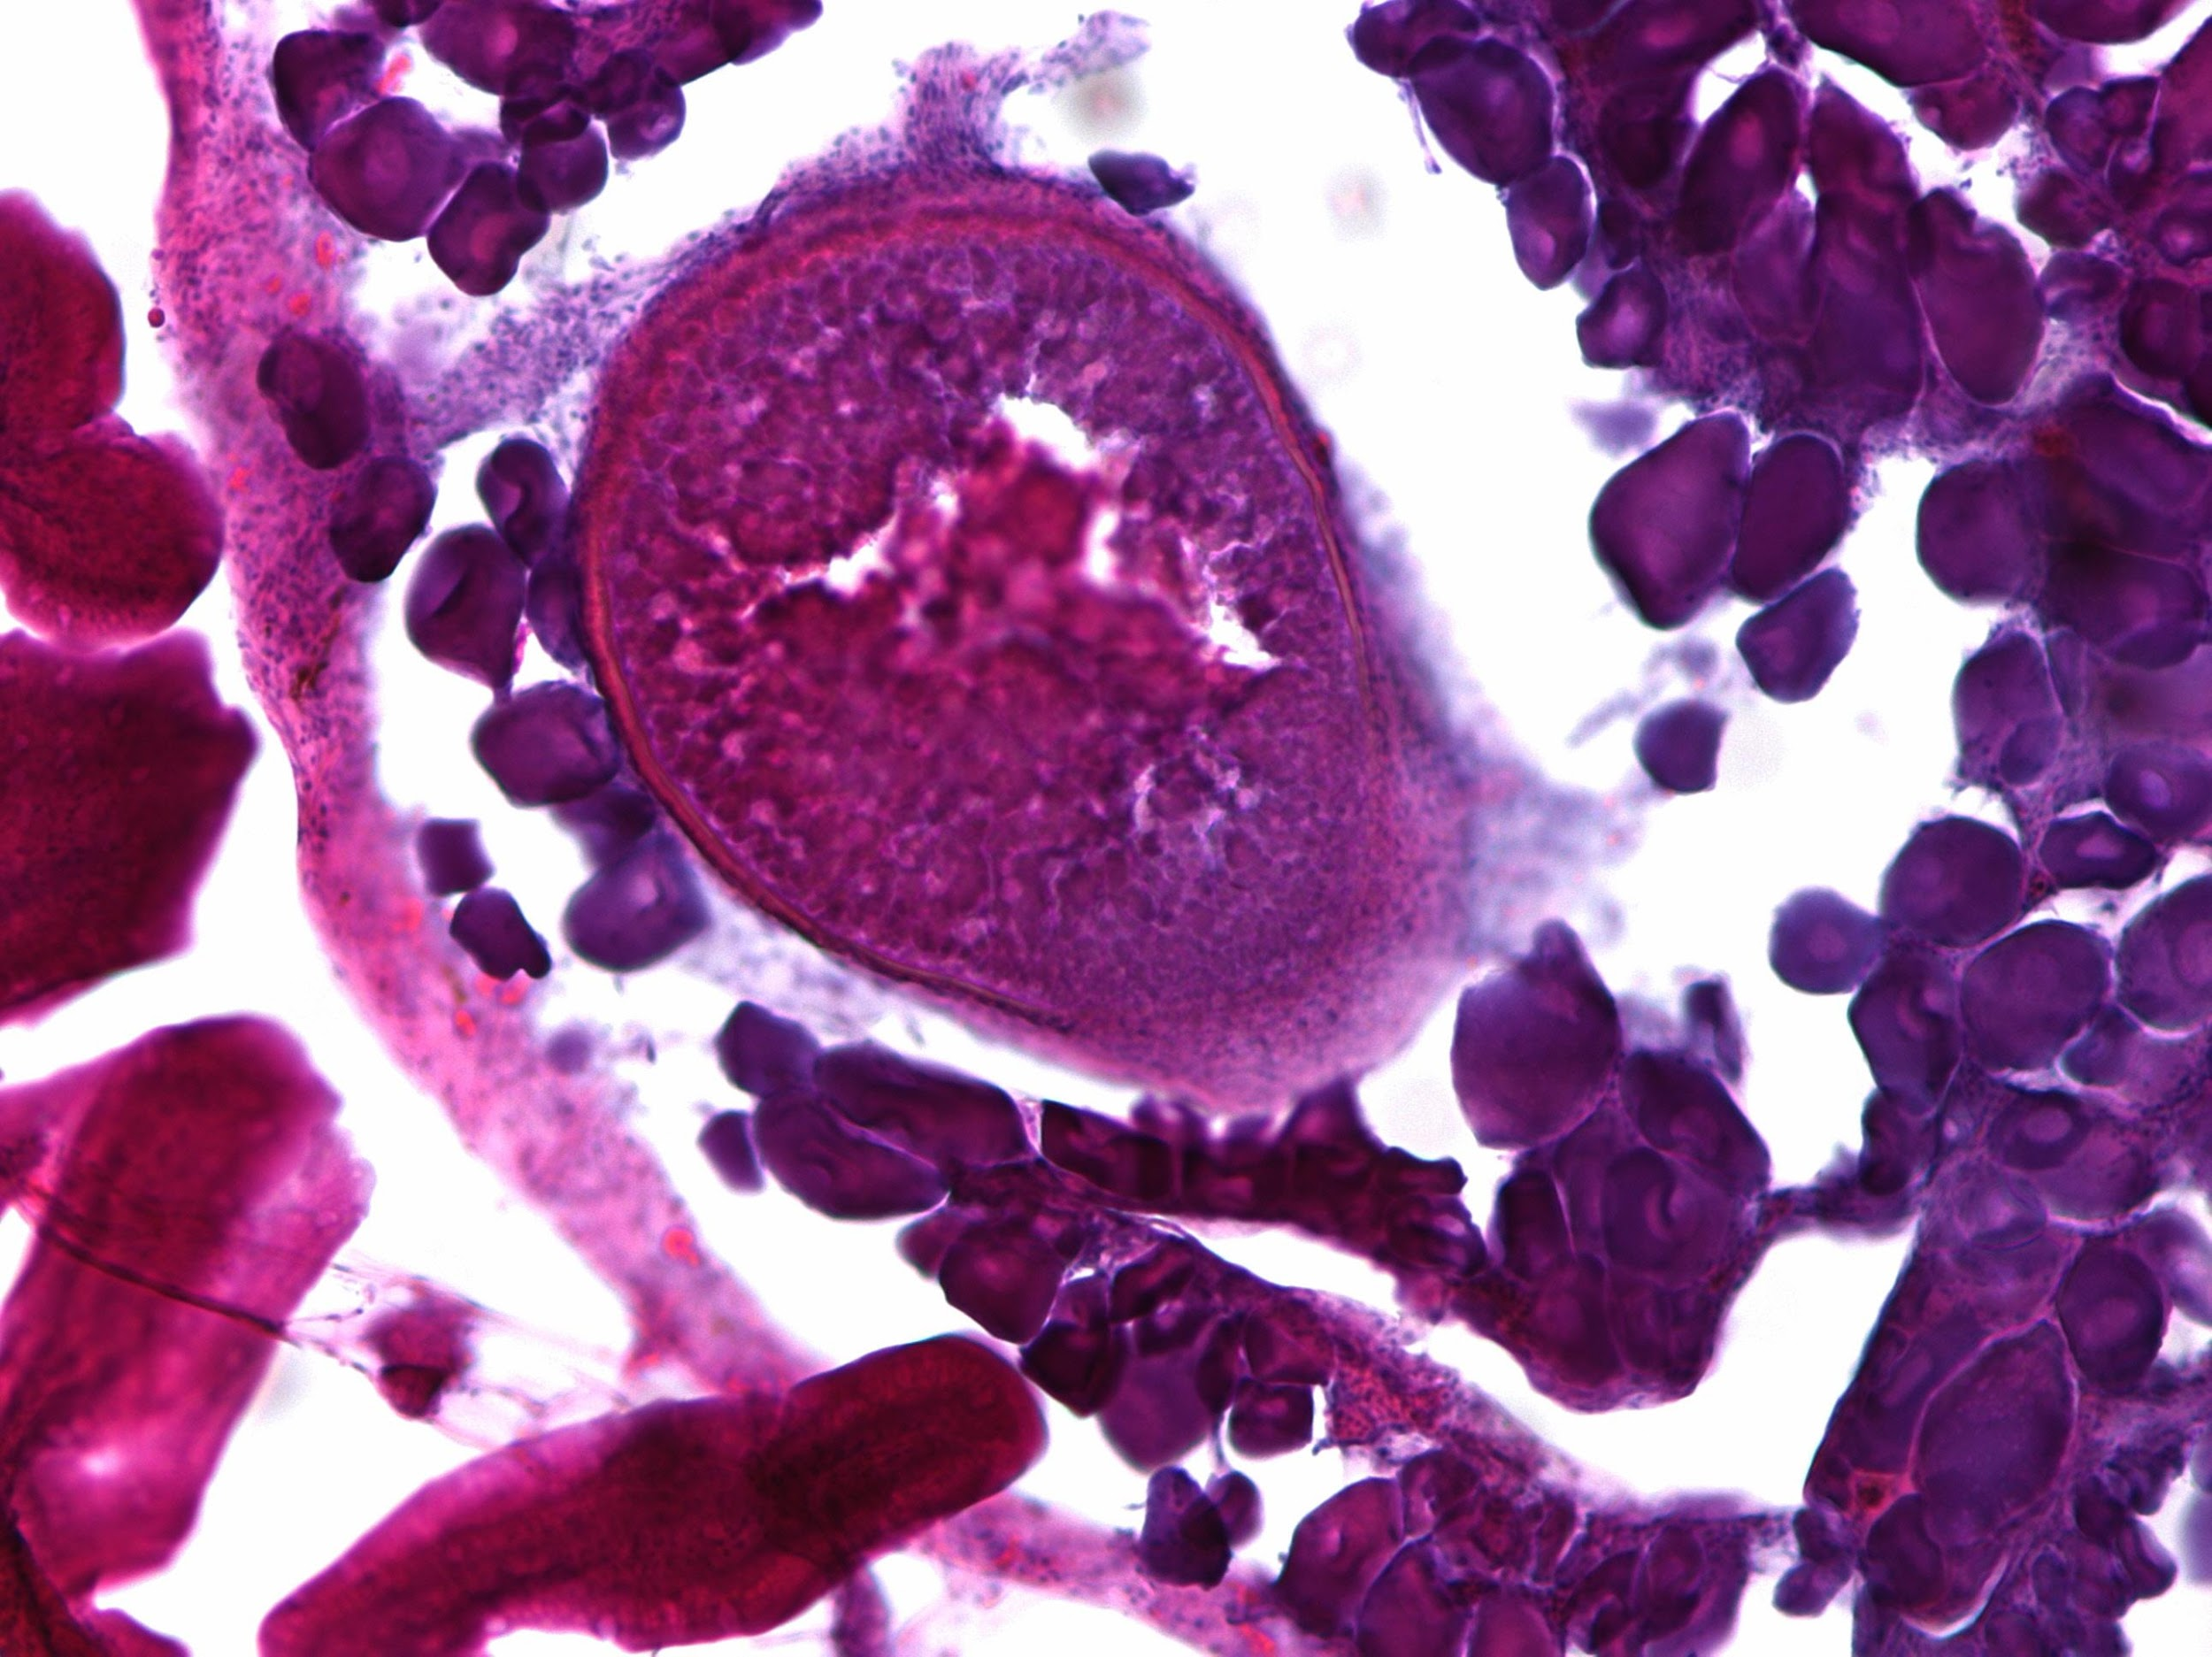
A
Parameter
Max
11KT
E2
Percent Testicular
Vitellogenesis
Body Mass
Neurogenesis
Min
Aggression
♂
I
LI
♀
Parental Care
♂
IP
LIP
♂
Sex Change Progression
B
C
D
Male
800
ab
bc
bc
a
ab
c
ab
abc
80%
d
b
ab
a
c
cd
600
60%
Testicular %
Parental Behaviors
40%
400
7.64x
Intermediate
200
2.21x
3.88x
11.08x
20%
0
0%
F
M
I
IP
LI
LIP
NF
NM
100%
M
I
IP
LI
LIP
NM
ab
c
bc
a
abc
bc
a
abc
a
c
c
b
b
ab
600
Phase
Phase
80%
400
1.69x
1.84x
Ovarian %
Time in nest (s)
2.14x
60%
Late Intermediate
200
10.67x
40%
0
F
M
I
IP
LI
LIP
NF
NM
20%
3.5
a
d
cd
bc
a
bcd
ab
bcd
c
ab
a
c
abc
bc
Phase
0.3
Phase
3.0
Female
2.5
1.11x
0.0
Corrected Volume
Log10 11KT (pg/ml)
1.85x
1.69x
1.35x
2.0
-0.3
1.5
-0.6
F
M
I
IP
LI
LIP
NF
NM
M
I
IP
LI
LIP
NM
Phase

Slide 2
Fig.1. Male, intermediate, and female anemonefish display distinct physiology and behavior. (A) Schematic outlining the behavioral and physiological changes that occur during protandrous sex change in anemonefish. (B) Top panel: Parental behaviors observed during a parental care assay. Middle panel: Time spent in the nest during parental care assay; a proxy for parental care. Bottom Panel: Log10 transformed serum 11-ketotestosterone. (C)Top panel: Percent of the gonad made of testicular tissue. Middle panel: Percent of the gonad made of ovarian tissue. Bottom panel: Gonadal volume corrected for the individual’s length (methods). (D) Example hematoxylin and eosin stains of gonads from the major phases of sex change. In B, plots are subdivided such that the dominant and subordinate individuals from each pair appear together reflected by shape and color.. Arrows indicate fold-difference between the two groups. In B, C, crossbar indicates mean, error bars indicate standard error of the mean (SEM). Letters indicate significance: groups that do not share a letter are significantly different.

Slide 3
A
13
B
11
12
26
4
1
15
17
25
7
22
3
9
24
2
6
0
18
8
21
5
UMAP_2
14
19
20
16
UMAP_1
10
23
C
Scaled Proportion of Region
Multiome Cluster
D
Multiome Cluster

Slide 4
Fig.2. Multiomics capture high quality transcriptomes, epigenomes, and spatial transcirptomes, (A) UMAP embeddings of our sn-Multiome data with each cluster numbered. (B) Dotplot showing canonical and data-driven markers for each of our multiome clusters. (C) Heatmap showing the scaled proportion of each neuroanatomical region made of each multiome cluster (see supplement xx for abbreviations). (D) Example projections of multiome clusters onto representative brain sections. The dashed line indicates approximately where we dissected brains for sn-multiomics analysis. Below each section is a sketch of an A. ocellaris brain with a line indicating the approximate sectioning plane for the given section.

Slide 5
A
1_RGC
B
6_POA_Mixed
E
1.00
First Changes
Glutamatergic
p = 0.907
**
0.75
GABAergic
20%
**
***
p = 0.51
*
Mixed
Prediction
Glial
15%
10%
0.50
% of Cells
% of Neurons
0.25
Last Changes
10%
5%
5%
0.00
2_OL
5_Glut
16_Glut
11_MG
1_RGC
17_Glut
18_Glut
8_VOT_Glut
12_Glut
0%
0%
10_nHv_Glut
19_Di_GABA
0_Spall_Mixed
4_TGN_Glut
3_Spall_GABA
M
I
LI
NF
F
M
I
LI
NF
F
21_Spall_GABA
6_POA_Mixed
C
Phase
50
40
30
DEGs
20
10
Classification
0
Early Down
2_OL
5_Glut
11_MG
15_EC
26_DG
1_RGC
12_Glut
16_Glut
9_Mixed
13_OPC
17_Glut
20_Leuko
25_GABA
7_Pall_Glut
10_nH_Glut
18_Glut
22_Di_Glut
Early Up
0_Spall_Mixed
4_TGN_Glut
8_VOT_Glut
19_Di_GABA
23_NLT_GABA
3_Spall_GABA
6_POA_Mixed
14_Vsst_GABA
21_Spall_GABA
24_Vs-m_Mixed
Late Down
D
Late Up
9
Progressively Down
Progressively Up
6
Transiently Down
DARs
Transiently Up
3
0
2_OL
5_Glut
11_MG
15_EC
26_DG
1_RGC
12_Glut
16_Glut
9_Mixed
13_OPC
17_Glut
20_Leuko
23_NLT
25_GABA
7_Pall_Glut
10_nH_Glut
18_Glut
22_Di_Glut
0_Spall_Mixed
4_TGN_Glut
8_VOT_Glut
19_Di_GABA
3_SPall_GABA
6_POA_Mixed
14_Vsst_GABA
21_SPall_GABA
24_Vs-m_Mixed

Slide 6
Fig.3. Cells change composition, transcriptome, and epigenome asynchronously during sex change. (A) The percent of all cells in our dataset belonging to 1_RGC. (B) The percent of all neurons in our dataset belonging to 6_POA_Mixed. (C) The number of differentially expressed genes (DEGs) by multiome cluster. (D) The number of differentially accessible regions (DARs) by multiome cluster. (E) Machine learning predictions for the mean sex of intermediates based on their expression of DEGs and DARs by multiome cluster; a proxy for the temporal order of sex change Shape and color represents broad cell type. In C, D, bars are colored based on our classification for the manner in which they change sex (see methods). In A, B, points indicate the proportion for each individual. Asterisks: “*”: p < 0.05, “**”: p < 0.01, “***”: p < 0.001.

Slide 7
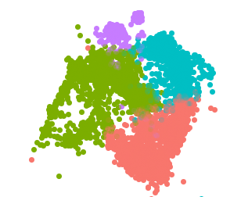
A
cyp19a1b
B
DEGs
3
p = 0.283
***
***
M
I
F
Expression
2
†
†
†
†
†
†
§
§
†
†
†
sox6
gli1
rpl24
cog5
lrch4
lhfpl3
tap2t
plce1
glceb
pcnx4
foxp2
fgfbp3
dab1a
ssbp4
1
mical2b
kcnh6a
immp2l
skida1
tmed4
tmtc2b
nkx2.2a
slc44a2
znf710b
nlrc3-like
gjc1-like
il1rapl1a
brd3-like
sema3ab
ccdc85cb
cyp19a1b
fmnl1-like
lrrc49-like
jam3b-like
dbx1b-like
pp1r37-like
zgc:113263
pknox2-like
dnmt3bb.1
LOC129348729
arhgef28-like
COUPTFII-like
M
I
LI
NF
F
LOC129348282
LOC111583974
LOC111564869
Phase
C
Z-Score
Classification
1_RGC
1_gfap
2
1
0
-1
-2
Late Up
1_shha
Late Down
1_NP
Transiently Up
Type
Transiently Down
1_NSC
Early Up
†
Early Down
UMAP_2
Transcription Factor
§
Chromatin Modifier
Progressively Down
UMAP_2
UMAP_1
UMAP_1
1_NP
p.adjust
D
E
neuron differentiation
1.00
c
a
b
b
axon guidance
0.0005
0.75
Wnt signaling pathway
0.0010
Negative regulation of forebrain development
0.0015
CytoTRACE
canonical Wnt signaling
0.50
central nervous system development
0.25
cell fate commitment pathway
Count
canonical Wnt signaling pathway
5
1_NP
frizzled binding
10
1_shha
1_NSC
1_gfap
negative regulation of axon extension involved in axon guidance
Subcluster
15
0.02
0.04
0.06
0.08
0.10
G
GeneRatio
F
1_NSC
1_NP
H
neuron differentiation
1_NP
80%
p = 0.356
**
0.07
**
60%
**
*
75%
*
***
p = 0.51
**
0.06
% of 1_RGC
50%
AUC Score
40%
20%
25%
0.05
0%
M
I
LI
NF
F
0%
M
I
LI
NF
F
M
I
LI
NF
F
Phase

Slide 8
Fig.4. Radial glial cells undergo changes in transcriptome and subtype composition over the course of sex change. (A) Brain aromatase (cyp19a1b) expression in 1_RGC. (B) A heatmap showing all DEGs by phase in 1_RGC. Cells are colored by z-score of the mean expression for each phase. The top bar indicates the classification for how each gene changes sex, and the symbols below the matrix indicate what kind of gene each DEG is. (C) UMAP showing subclustering of 1_RGC. (D) Mean CytoTRACE score for each individual by subcluster. A higher score indicates a less mature cell type. Significance is indicated by letters, subclusters who do not share a letter are significantly different from eachother. (E) Gene ontology (GO) analysis for the marker genes of 1_NP. Color indicates false discovery rate adjusted p value, point size indicates the number of genes annotated with that term, and “GeneRatio” indicates the proportion of genes annotated with that GO term divided by all annotated genes in our list. (F) Percent of 1_RGC composed of 1_NSC. (G) Percent of 1_RGC composed of 1_NP. (H) AUCell score of a gene expression module composed of genes labeled with the GO term “neuron differentiation” in 1_NP. (I) Schematic describing our model for how neurogenesis changed over the course of sex change. In A, F-H, points indicate the mean for each individual. Asterisks: “*”: p < 0.05, “**”: p < 0.01, “***”: p < 0.001.

Slide 9
A
6_POA_Mixed
D
ECM DEG+
ECM DEG-
E
6_POA_Mixed
1.0
***
0.8
*
p = 0.103
p = 0.110
0.8
p = 0.771
*
p = 0.960
p = 0.108
0.7
p = 0.268
**
CytoTRACE
0.6
0.6
0.4
0.5
0.2
0.4
UMAP_2
M
I
LI
NF
F
M
I
LI
NF
F
M
I
LI
NF
F
UMAP_1
Phase
DARs
F
0.12
brain development
G
axon guidance receptor activity
B
p = 0.785
0.200
p = 0.405
F
0.10
**
***
0.175
**
*
I
AUC Score
0.08
0.150
M
2
0.125
†
h4
1
M
I
LI
NF
F
M
I
LI
NF
F
M
I
F
capn2-like
psme4a
Phase
C
Z-Score
† ECM / Cell Adhesion
§ Gonadotroph Associated
0
Type
Classification
DEGs
Early
Up
-1
Transiently
Up
-2
Late
Down
Late
Up
§
†
†
†
†
†
§
§
§
Early
Down
§
†
§
†
†
pgr
drd3
ell
Transiently
Down
sdc2
mxi1
chgb
cntn4
rgs5b
pim3
nmbr
bcan
gfra3
wdfy2
ptprfa
npy7r
nova2
grm5a
ca16b
tacr3a
picalm
stxbp6
nudt4a
ar-like
gabra3
ptprz1a
dse-like
pde1cb
cd87-like
rgs9-like
kcn4-like
camk2g2
ca10-like
pcdh10b
ldlrp8-like
nxph1-like
gsta1-like
kcnd3-like
capn1-like
frmpd4-like
tenm3-like
sinhcaf-like
myo1c-like
shisal2a-like
znf385C-like
lmbrd2b-like
slc25a1-like
cntnap4-like
gpcr22-like
neurl1-like
LOC111565841
LOC111575683
LOC118470193
Progressively
Up

Slide 10
Fig.5. 6_POA_Mixed undergoes changes in transcriptome and epigenome consistent with neurogenesis. (A) UMAP projection with 6_POA_Mixed highlighted. (B) DARs in 6_POA_mixed. (C) DEGs in 6_POA_Mixed. In B, C, cells are colored by z-score of the mean accessibility or expression for each phase. The top bar indicates the classification for how each gene or region changes sex, and the symbols below the matrix indicate what kind of gene is differentially accessible or differentially expressed. (D) CytoTRACE score by phase split by whether the cell expresses a DEG associated with the extracellular matrix (ECM-DEG) or not. (E) CytoTRACE score for 6_POA_Mixed as a whole. (F) AUCell score for a gene expression module made of genes annotated with the GO term “brain development”. (G) AUCell score for a gene expression module made of genes annotated with the GO term “axon guidance receptor activity”. In D-G, points indicate the mean for each individual. Asterisks: “*”: p < 0.05, “**”: p < 0.01, “***”: p < 0.001.

Slide 11
A
drd3
**
**
p = 0.586
**
7.5%
p = 0.503
*
Main effect p > 0.05
0.15
1.0
Expression
Percent drd3+
CytoTRACE
0.10
5.0%
0.05
2.5%
0.5
0.00
0.0%
B
M
I
LI
NF
F
M
I
LI
NF
F
M
I
LI
NF
F
tacr3a
**
*
**
Main effect p > 0.05
0.4
p = 0.074
***
***
1.00
20%
CytoTRACE
Expression
Percent tacr3a+
0.75
0.2
10%
0.50
0.0
0%
M
I
LI
NF
F
M
I
LI
NF
F
C
M
I
LI
NF
F
cckb
Main effect q > 0.05
*
1.0
*
0.75
30%
p = 0.629
*
0.8
p = 0.537
**
20%
CytoTRACE
Expression
Percent cckb+
0.50
0.6
0.25
10%
0.4
M
I
LI
NF
F
0%
M
I
LI
NF
F
M
I
LI
NF
F
Phase
Notes:
I will make a model to put below this once I get an illustrator subscription

Slide 12
Fig.6. Changes to 6_POA_Mixed Drive Differential Regulation of Gonadotrophs. (A) Left panel expression of drd3 by phase. Middle panel: Percent of 6_POA_Mixed cells expressing drd3 by phase. Right panel: CyoTRACE score for drd3+ cells by phase.(B) Left panel expression of tacr3a by phase. Middle panel: Percent of 6_POA_Mixed cells expressing tacr3a by phase. Right panel: CyoTRACE score for tacr3a+ cells by phase.(C) Left panel expression of cckb by phase. Middle panel: Percent of 6_POA_Mixed cells expressing cckb by phase. Right panel: CyoTRACE score for cckb + cells by phase. Points indicate the mean for each individual. Asterisks: “*”: p < 0.05, “**”: p < 0.01, “***”: p < 0.001. “Main effect Main effect p > 0.05” indicates type III tests were not significant so pairwise comparisons were not computed.

Slide 13
A
16
B
d
ab
c
a
c
ab
bcd
abc
d
ab
c
a
cd
ab
bcd
abc
12
8
Mass (g)
Length (cm)
1.44x
8
3.12x
6
1.31x
1.28x
1.28x
4
2.33x
2.19x
2.52x
F
M
I
IP
LI
LIP
NF
NM
4
F
M
I
IP
LI
LIP
NF
NM
Phase
Supplementary Fig.1. (A) Body mass by phase. (B) Body length by phase. Plots are subdivided such that the dominant and subordinate individuals from each pair appear together reflected by shape and color.. Arrows indicate fold-difference between the two groups. Crossbar indicates mean, error bars indicate standard error of the mean (SEM). Letters indicate significance: groups that do not share a letter are significantly different..
Notes:
Supplementary physiology

Slide 14
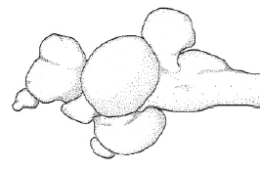
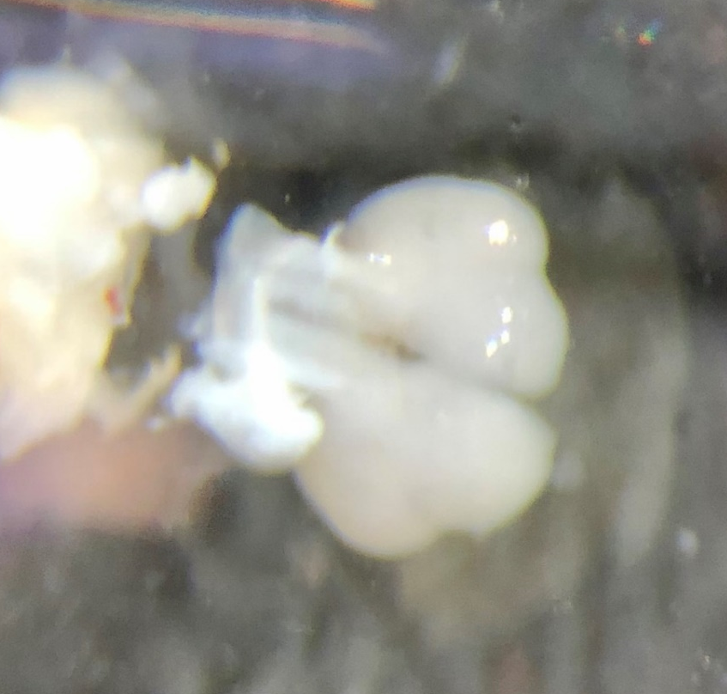
3
2
4
1
POA
Blue dotted lines represent cuts made
POA

Slide 15
Dm-3
Dm-3
Vs-m
Dm-3
D
Dln
d
Dl-g
-
c
-
Dl-g
Vs-m
d
V
Vd-c
s-m
Dln-r
Dl-v
Vv
Dl
E
ac
Dln-r
Dl-v
E
-
g
nP
P
D
a
d
-
v
nM
M
n
p
nPPa
nPPa
P
M
ON
p
Dl-g
Dm-3
Dln-c
O
Dm
T
Dln-r
Dp
Dd-v
TL
TL
Dd-v
E
nMMp
Dp
Vp
P
nPMp
V
nGMp
PS
ON
nPPp
i
nMMp
PS
I
P
TLa
lln
ON
nPPp
Gn
PGm
TLa
Gn
PGm
PGa
PGa
SN
NRL
CM
CM
ND
I
NDILI
NDILm
NDILI
lm
Dm-1
Dm-3
NRL
Dl-g
Dl-g
Dln-r
Dm-2r
Vs-m
Vd-r
n
H
nHd
v
nhD
Dl-v2
Vv
Vv
V
Vl
nPPa
Dl-v2
M
O
n
T
n
H
O
PSi
v
CP
T
ln
NC
PSi
nP
P
p
nP
P
PSm
NC
CP
p
Dm-3
Dm-1
A
T
TLa
n
TLa
Dl
Dl-g
-
A
g
T
n
s-m
Dln-r
NDILI
Dln-r
V
N
L
T
i
NDILI
V
Vd-r
d
-
V
c
Dl
c
-
Dm-3
v
V
Dl-v
Vv
Dm-1
v
Vl
V
Dl
-
Dl
d-r
g
-
g
V
Dln-r
d-r
Dl
-
Dl
v2d
Dl
-
v2d
-
Dm
Dm-3
Dl
v2
-
v2
V
Dln
s-m
-
c
O
Dp
Dp
T
V
Dm-3
D
i
Dm-3
d
V
Dl
i
E
-
gd
D
c
-2
n
E
nM
TE
M
O
p
D
T
c
-2
nG
M
Dl
PSP
p
-
V
g
n
P
M
V
p
s-m
nP
P
Dl
s-m
p
-
g
PSP
nP
ON
P
ON
p
N
L
Dl
T
-
v2
P
G
V
a
c
V
d-r
P
G
V
a
sst
V
Dl
V
d-r
-
v2
sst
Dm-1
V
v
V
v
Dm-1
Dm-2r
Dl
Dm-3
Dln-r
-
gd
D
c
-2
V
O
d-r
d-r
T
Dl
-
g
V
V
s-m
Dl
-
T
v2
P
p
nP
P
a
Dl
-
Dl
v2
-
v2
V
sst
nP
P
nM
a
M
ON
nG
p
nPMp
M
p
Dm-3
s-m
Dm-3
V
V
d
-
c
Dl
-
Dl
v2
-
v2
V
V
d-r
NC
c
V
nHd
n
v
H
O
v
T
PSm
V
V
l
M
n
V
CP
V
v
nG
PSm
c
M
p
V
T
l
GN
nG
M
nP
p
P
p
V
O
PGm
T
nP
P
TLa
A
p
T
n
T
N
TLa
Gn
NP
nHd
nHd
L
T
d
A
T
N
n
L
T
m
n
H
A
v
n
n
H
O
v
N
T
L
T
NDILm
d
ln
O
NDILI
A
T
V
n
CP
M
NRL
NDILI
NC
n
nG
M
N
PS
p
L
T
v
nP
P
p
nP
P
PGm
p
N
L
T
T
d
GN
PGm
TLa
TLa
T
A
GN
T
n
A
T
NRL
N
n
L
T
d
N
L
T
O
i
NRL
T
N
L
T
TLa
NDILI
v
NDILI
NDILI
Notes:
Work in progress, I will make better

Slide 16
Supplementary Fig.2. Drawings of each section sequenced with VisiumHD with neuroanatomical regions labeled.

Slide 17
Parker 2024 Parent Clusters
Parent Cluster
Scaled Proportion
of Region

Slide 18
A
Cells
0_Spall_Mixed
1_RGC
2_OL
3_Spall_GABA
4_TGN_GABA
7_Pall_Glut
***
25%
p = 0.907
***
12.5%
**
**
p = 0.799
***
30%
p = 0.779
***
20%
**
***
20%
***
***
10.0%
p = 0.107
p = 0.211
10%
**
9%
*
***
20%
15%
15%
7.5%
6%
10%
10%
10%
5.0%
5%
3%
5%
5%
2.5%
0%
0%
0%
0%
0%
0.0%
M
I
LI
NF
F
M
I
LI
NF
M
I
LI
F
NF
F
M
I
LI
NF
M
I
LI
F
NF
F
M
I
LI
NF
% of Cells
F
9_Mixed
11_MG
12_Glut
19_Di_GABA
22_Di_Glut
24_Vs-m_Mixed
10.0%
***
**
6%
p = 0.094
4%
p = 0.848
**
**
7.5%
p = 0.158
**
6%
*
p = 0.347
4%
**
p = 0.235
3%
*
**
2%
p = 0.634
**
2%
p = 0.389
***
5.0%
4%
2%
2%
1%
1%
2.5%
2%
1%
0.0%
M
0%
0%
0%
0%
0%
I
LI
NF
F
M
I
LI
NF
F
M
I
LI
NF
F
M
I
LI
NF
F
M
I
LI
NF
F
M
I
LI
NF
F
Phase
Neurons
B
0_Spall_Mixed
4_TGN_GABA
7_Pall_Glut
9_Mixed
14_Vsst_GABA
30%
*
*
p = 0.27
***
10.0%
***
6%
*
*
***
10%
**
9%
p = 0.096
***
7.5%
p = 0.439
**
5%
**
p = 0.327
20%
6%
4%
5%
5.0%
3%
10%
3%
2.5%
2%
0%
0%
0.0%
1%
0%
M
I
LI
0%
NF
F
M
I
LI
NF
F
M
I
LI
NF
F
M
I
LI
NF
M
I
LI
F
NF
17_Glut
F
18_Glut
19_Di_GABA
22_Di_Glut
24_Vs-m_Mixed
% of Neurons
**
*
**
5%
**
p = 0.272
5%
*
4%
p = 0.515
4%
p = 0.086
4%
p = 0.715
3%
p = 0.053
**
2%
p = 0.378
**
2%
p = 0.229
***
3%
3%
2%
2%
2%
1%
1%
1%
1%
1%
0%
M
I
LI
0%
0%
0%
0%
NF
F
M
I
LI
NF
F
M
I
LI
NF
F
M
I
LI
NF
F
M
I
LI
NF
Phase
F
Supplementary Fig.3. (A) Percent of all cells belonging to each multiome cluster. (B) Precent of all neurons belonging to each multiome cluster. Only significant results are shown. Points indicate the mean for each individual. Asterisks: “*”: p < 0.05, “**”: p < 0.01, “***”: p < 0.001.

Slide 19
igf2bp3
pax3b
1_RGC DARs — Mean Z-Score by Phase
spice1
M
I
F
tdrd9
†
gls1-like
2
gabrb1
1
pik3c2b
Label
Z-Score
Type
0
†
Late Down
Transcription Factor
Late Up
fam172a
-1
Progressively Down
LOC129348612
Progressively Up
-2
Supplementary Fig.4. DARs in 1_RGC. Cells are colored by z-score of the mean accessibility or expression for each phase. The top bar indicates the classification for how each gene or region changes sex, and the symbols below the matrix indicate what kind of gene is differentially accessible or differentially expressed. (B)
plekhm3
sorbs2a

Slide 20
A
1_NSC
p.adjust
D
Average Expression
dendrite
1e-07
axon
-1.0
-0.5
postsynaptic membrane
2e-07
0.0
0.5
1.0
postsynaptic density
Percent Expressed
postsynaptic density membrane
3e-07
0
20
40
60
80
dendritic spine
Count
lmx1.2-like
modulation of chemical synaptic transmission
50
proton transmembrane transport
100
synaptic membrane adhesion
pik3r5-like
Ionotropic glutamate receptor signaling pathway
150
0.02
0.04
0.06
LOC118470146
GeneRatio
p.adjust
B
1_gfap
six6a
collagen-containing
0.02
extracellular matrix
LOC129350005
0.03
axon guidance
ror1
Count
dopaminergic neuron
4
tmem266
differentiation
6
somite development
8
zkscan8-like
10
0.025
0.050
0.075
0.100
12
angpt1
GeneRatio
gfap
C
1_shh
p.adjust
axon guidance
0.005
shha
0.010
negative chemotaxis
0.015
cyp19a1b
anatomical structure
Count
0.020
formation involved in
4
morphogenesis
6
gja1b
0.04
0.06
0.08
0.10
0.12
0.14
8
GeneRatio
10
1_NSC
1_NP
1_shha
1_gfap
1_RGC Subcluster

Slide 21
Supplementary Fig.5. Gene ontology (GO) analysis for the marker genes of (A) 1_NSC, (B) 1_gfap, and (C) 1_shha. In A-C, color indicates false discovery rate adjusted p value, point size indicates the number of genes annotated with that term, and “GeneRatio” indicates the proportion of genes annotated with that GO term divided by all annotated genes in our list. (D) Canonical and data-driven marker genes for each 1_RGC subcluster

Slide 22
6_POA_Mixed DEGs:GO
p.adjust
GPCR signaling pathway
0.01
GPCR receptor activity
0.02
positive regulation of transcription by RNA pol III
0.03
protein tyrosine phosphatase activity
Count
learning or memory
2
non-membrane spanning protein tyrosine phosphatase activity
3
protein tyrosine phosphatase activity, metal-dependent
4
perineuronal net
5
estrogen response element binding
6
peptidyl-tyrosine dephosphorylation
7
0 .05
0.10
0.15
GeneRatio
Supplementary Fig.6. GO analysis of all of the DEGs in 6_POA_Mixed. Ccolor indicates false discovery rate adjusted p value, point size indicates the number of genes annotated with that term, and “GeneRatio” indicates the proportion of genes annotated with that GO term divided by all annotated genes in our list.

Slide 23
A
npy7r
***
**
0.15
**
p = 0.101
6%
p = 0.158
p = 0.114
0.10
Percent npy7r+
Expression
4%
0.05
2%
0.00
0%
M
I
LI
NF
F
M
I
LI
NF
F
nmbr
1.0
***
**
B
***
p = 0.935
40%
p = 0.487
*
0.8
30%
0.6
Percent nmbr+
20%
Expression
0.4
10%
0.2
M
I
LI
NF
F
0%
M
I
LI
NF
F
C
gnrh1
0.3
Main effect p > 0.05
8%
Main effect p > 0.05
0.2
Percent gnrh1+
Expression
4%
0.1
0.0
0%
M
I
LI
NF
F
M
I
LI
NF
F
D
0.5
pgr
*
**
p = 0.831
0.4
*
***
20%
p = 0.41
***
0.9
p = 0.5
p = 0.554
0.3
15%
CytoTRACE
Expression
Percent pgr+
0.6
0.2
10%
0.1
5%
0.3
0.0
0%
M
I
LI
NF
F
M
I
LI
NF
F
M
I
LI
NF
F
E
ar-like
1.00
p = 0.135
**
***
0.4
p = 0.62
***
p = 0.556
**
p = 0.491
p = 0.432
20%
0.75
0.3
CytoTRACE
Expression
Percent ar-like+
0.2
10%
0.50
0.1
0%
M
I
LI
NF
F
M
I
LI
NF
F
0.25
M
I
LI
NF
F
Phase

Slide 24
Supplementary Fig.7. Expression (left) and percent of 6_POA_Mixed (right) expressing (A) npy7r, (B) nmbr, (C) gnrh1. Expression (left) and percent of 6_POA_Mixed (middle), and CytoTRACE score (right) of cells expressing (D) pgr, (E), ar-like. Points indicate the mean for each individual. Asterisks: “*”: p < 0.05, “**”: p < 0.01, “***”: p < 0.001.

Slide 25
